Slide 1
Lezione 1 introduction & schematic
Stefan Cristi Zugravel 13/01/2026

Slide 2
Course Objectives
Manage hardware projects using Git version control
Design PCB schematics and layouts using KiCad
Perform basic SPICE simulations to validate critical circuits
Understand FPGA architecture and HDL design methodology
Develop, simulate, and synthesize simple VHDL modules
Use XILINX VIVADO and integrate IP cores

Slide 3
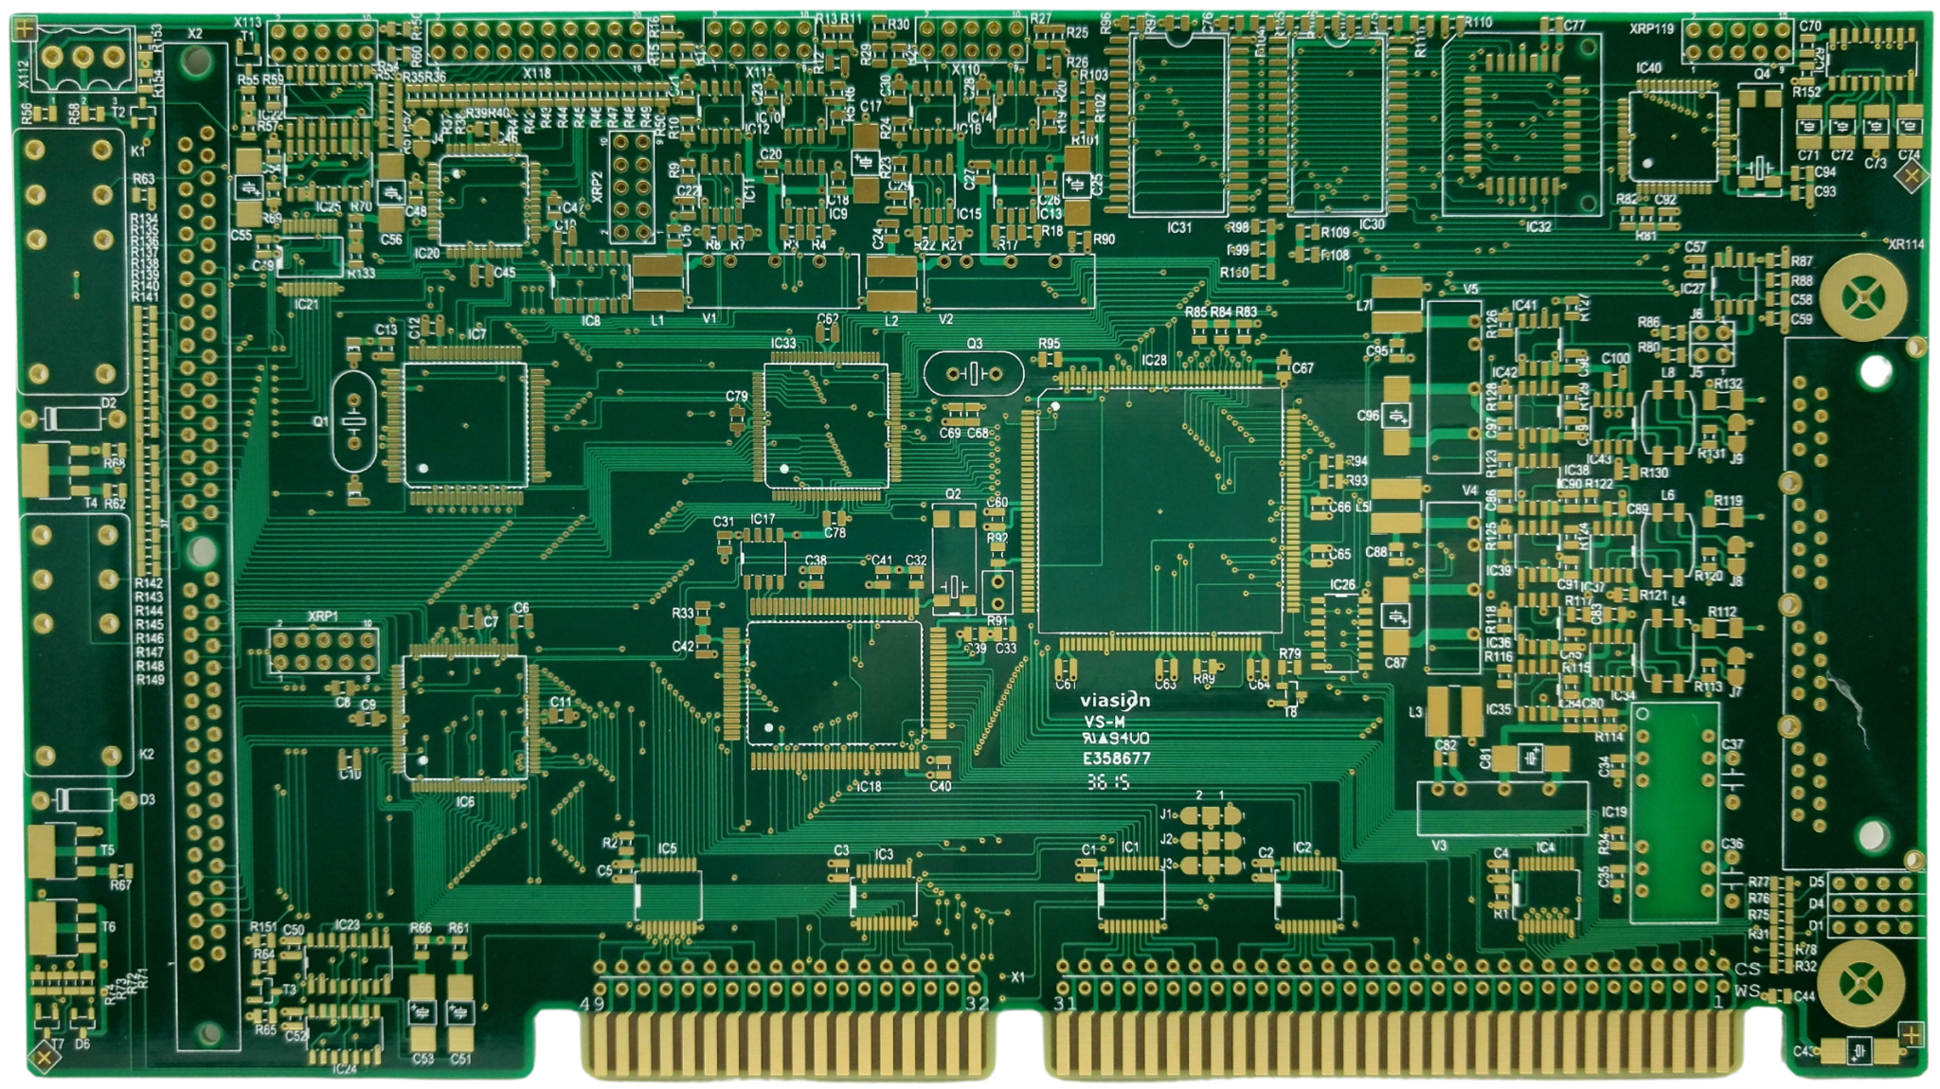
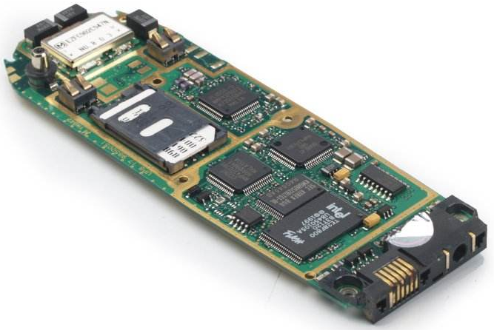
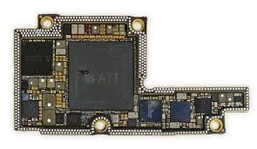
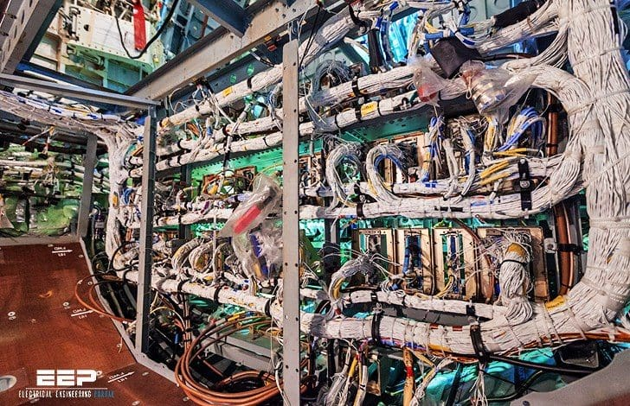
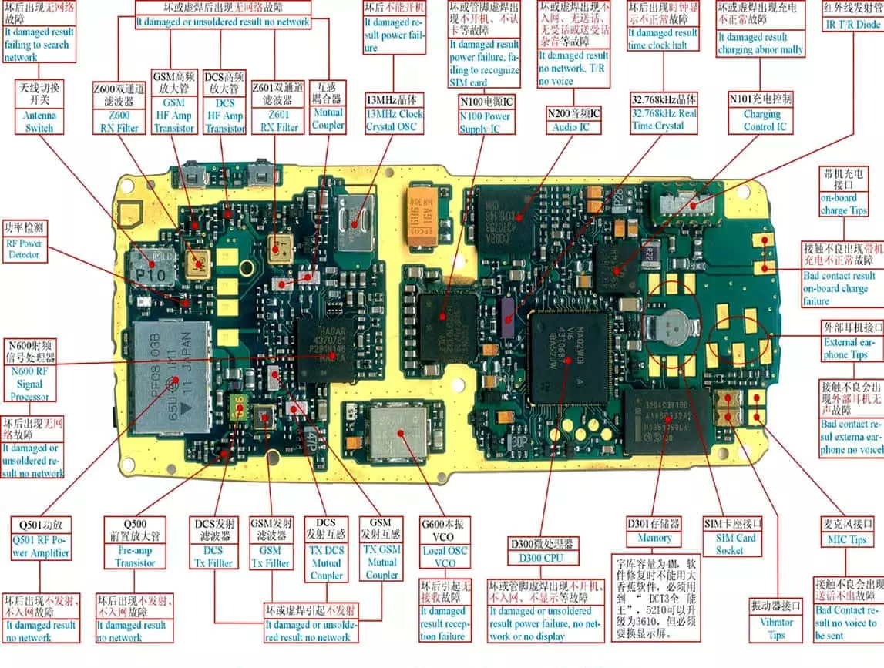
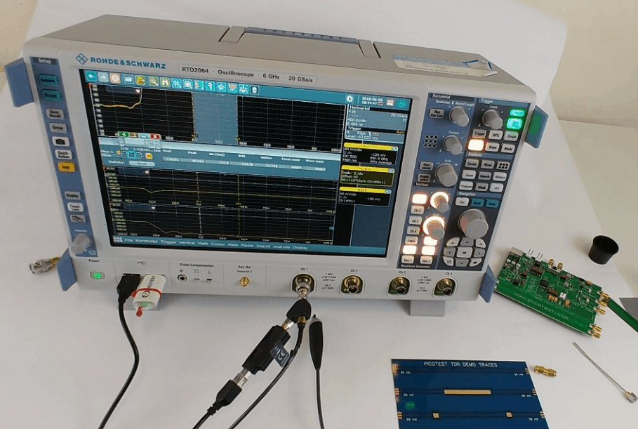
PCB, electronics
Consumer Electronics
Industrial & Automotive
Telecommunications & Networking
Medical Electronics
Aerospace, Defense, & Maritime
Lighting
Instrumentation
Ecc ….

Slide 4
Tools Used
Git (versioning)
Draw.io (block diagrams)
KiCad (Schematic & PCB)
NGspice & LTspice (simulation)
XILINX VIVADO (FPGA)

Slide 5
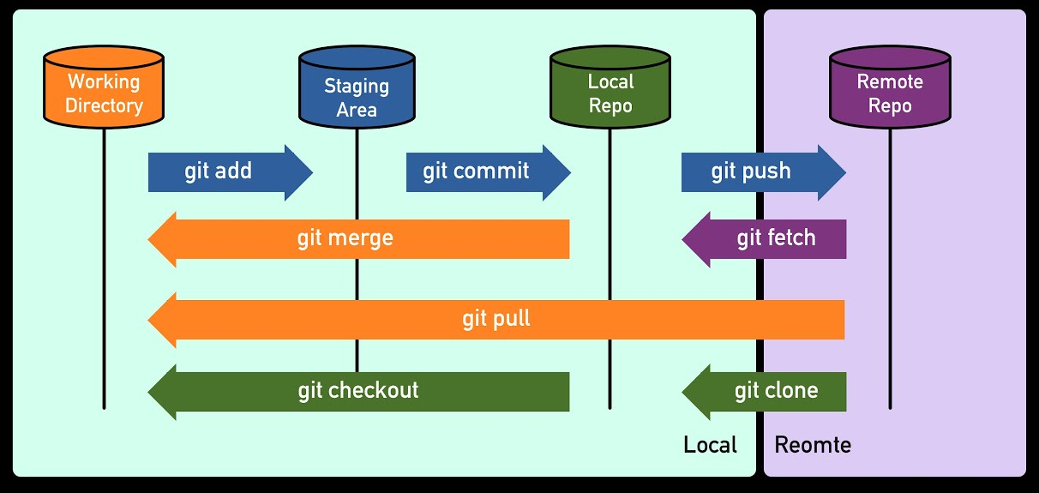
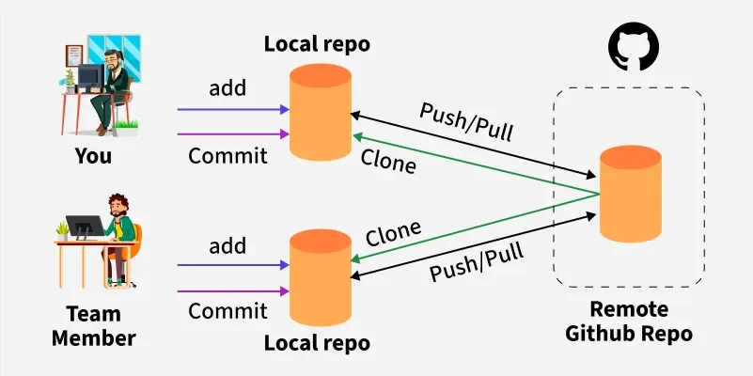
Git

Slide 6
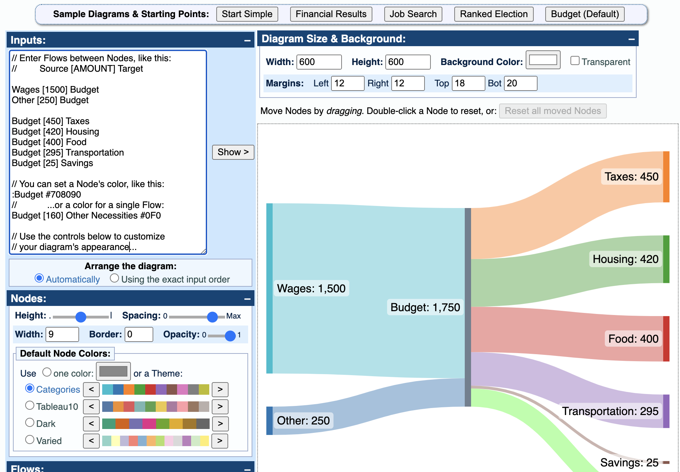
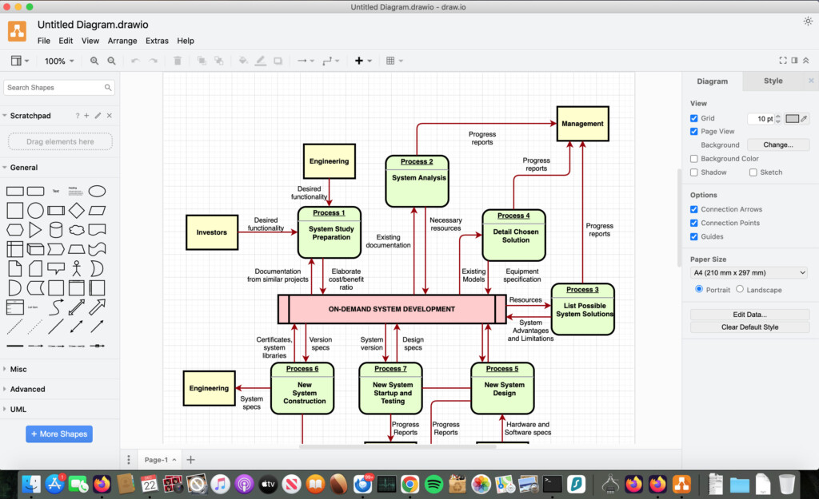
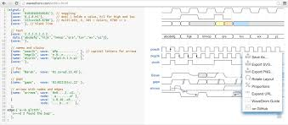
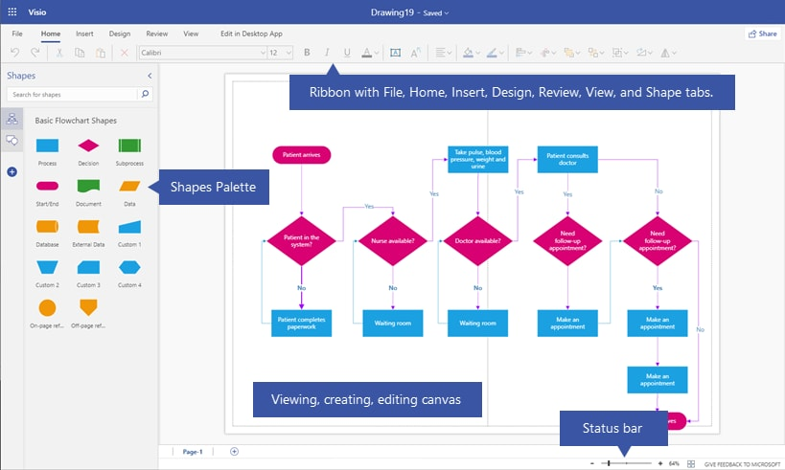
Draw.io – wavedrom – sankeymatic – MS Visio

Slide 7




Major Electronic Design Automation (EDA) vendors

Slide 8

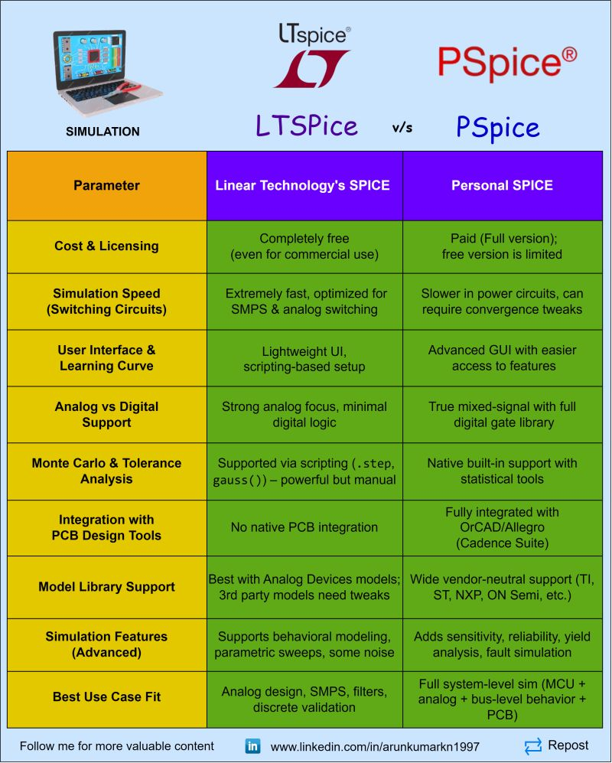
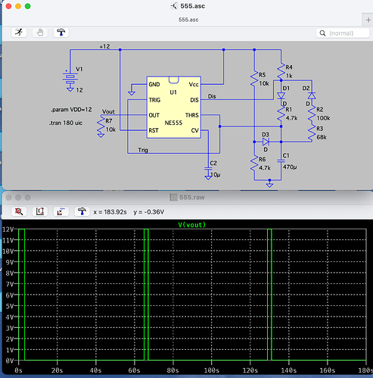

SPICE simulation

Slide 9


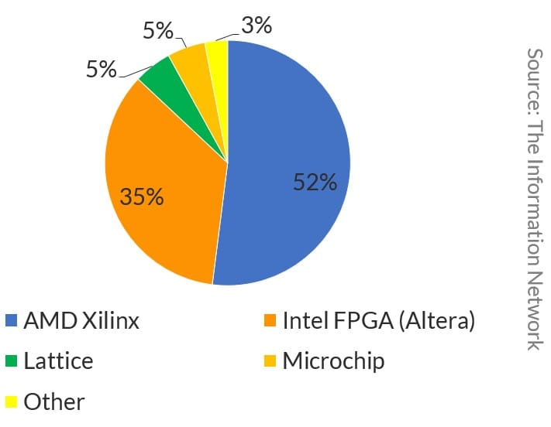



FPGA design suite

Slide 10
PCB design process
Gather requirements
Block diagram
Schematic Design
Simulation
Bill Of Materials
PCB Layout
(Simulation)
Manufacturing
Testing and validation

Slide 11
Gather requirements
Number of IO
Connector type
MAX bandwidth
Electromagnetic Interference (EMI) Electromagnetic Compatibility (EMC)
Sector regulations
Power and thermals
Size constraints
Parts availability
Time (development, production, validation)
Budget
Features

Slide 12
Course goal (Gather requirements)
Develop a custom module with:
8 analog inputs connected to a 12 bit 1 Msps ADC (sma 90° PCB mount connectors)
500 KHz -3 dB FEE bandwidth
Programmable gain/attenuation (-10 dB, 0 dB, +10 dB)
10 GPIO digital pins
1 analog out, buffered (0-3.3 V) – 1 MHz bandwidth – 12 bit resolution
FPGA data processing

Slide 13
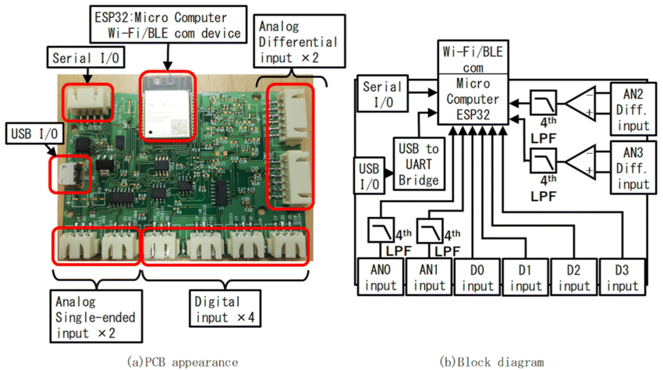
Block diagram

Slide 14
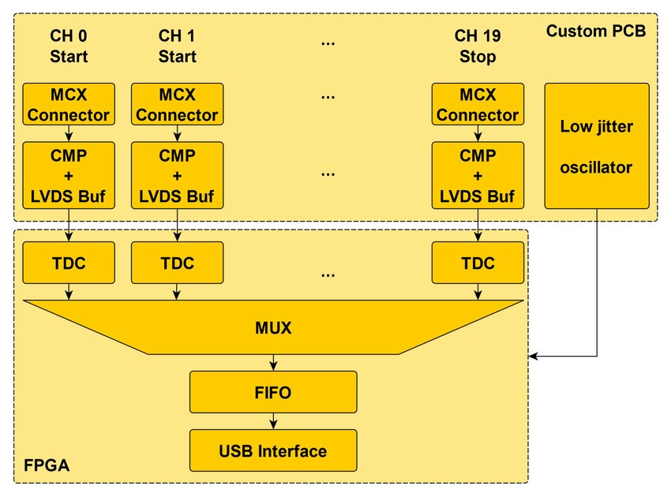
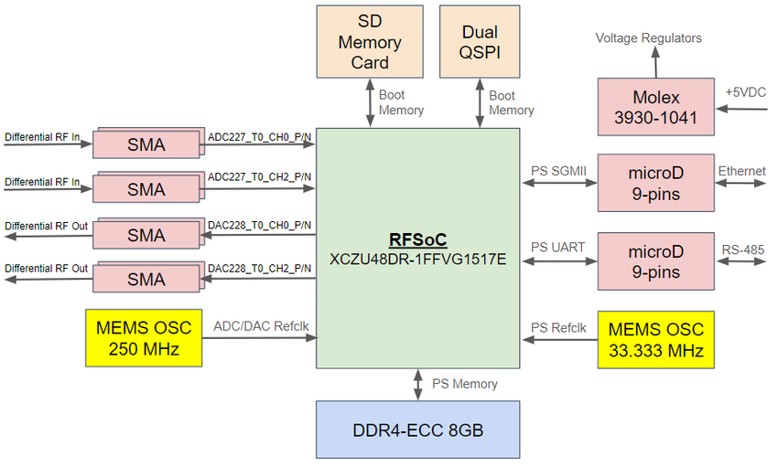

Slide 15
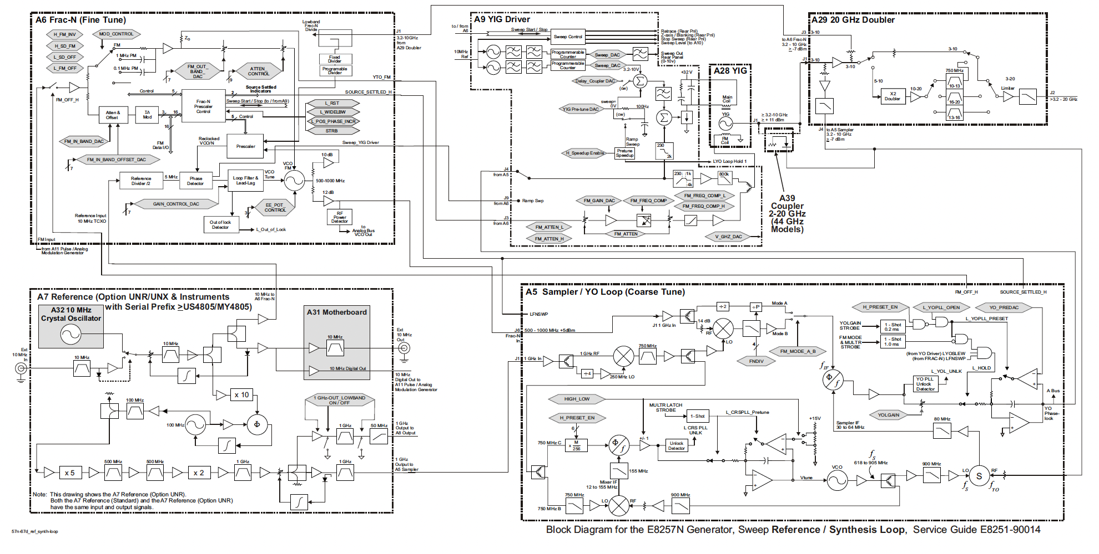

Agilent E8257D block diagram example

Slide 16
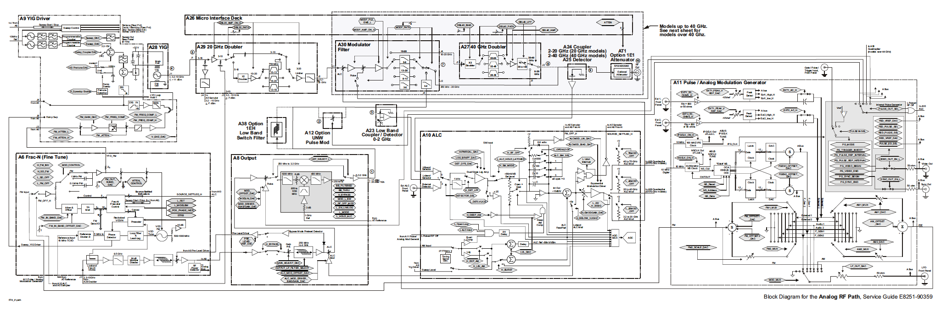
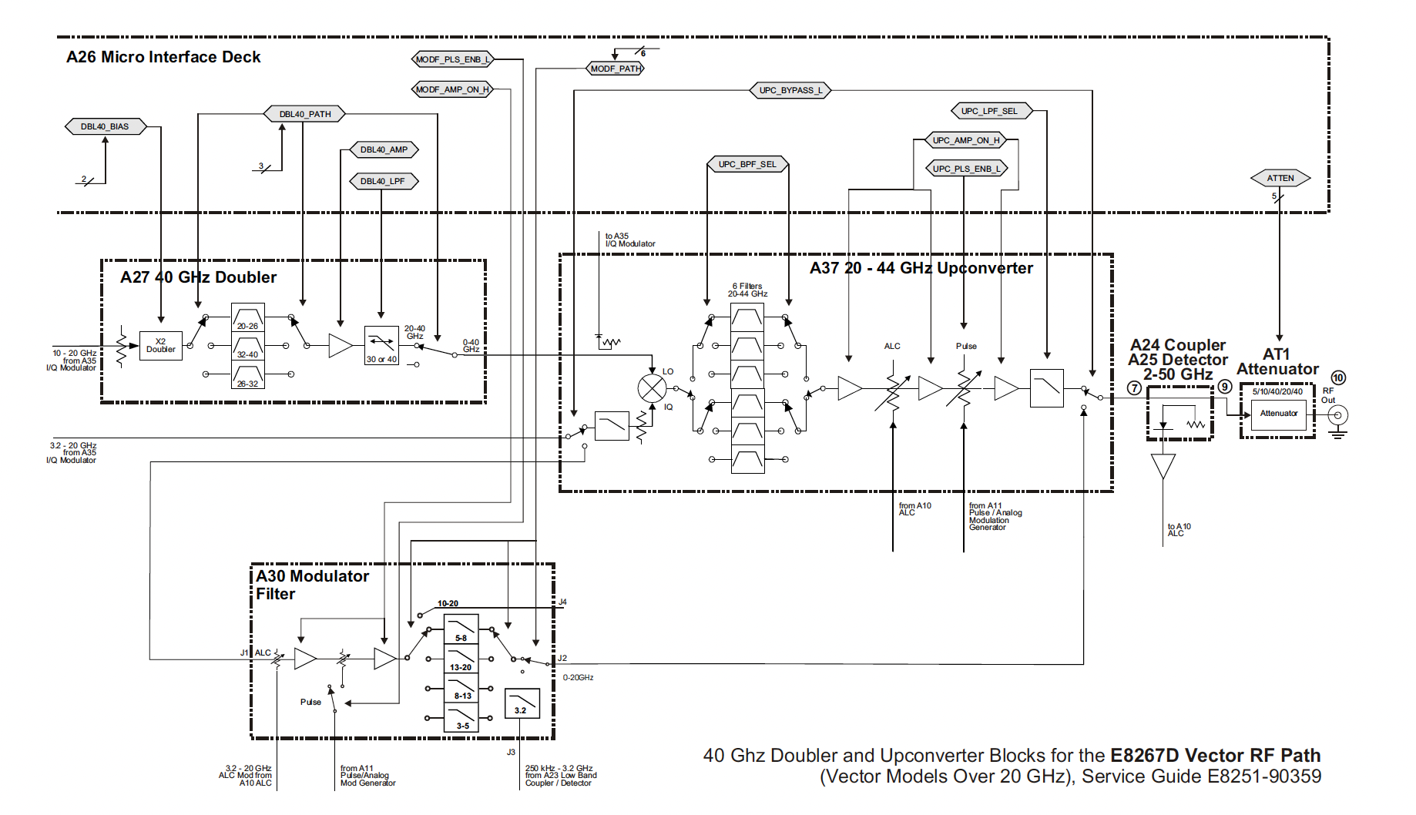
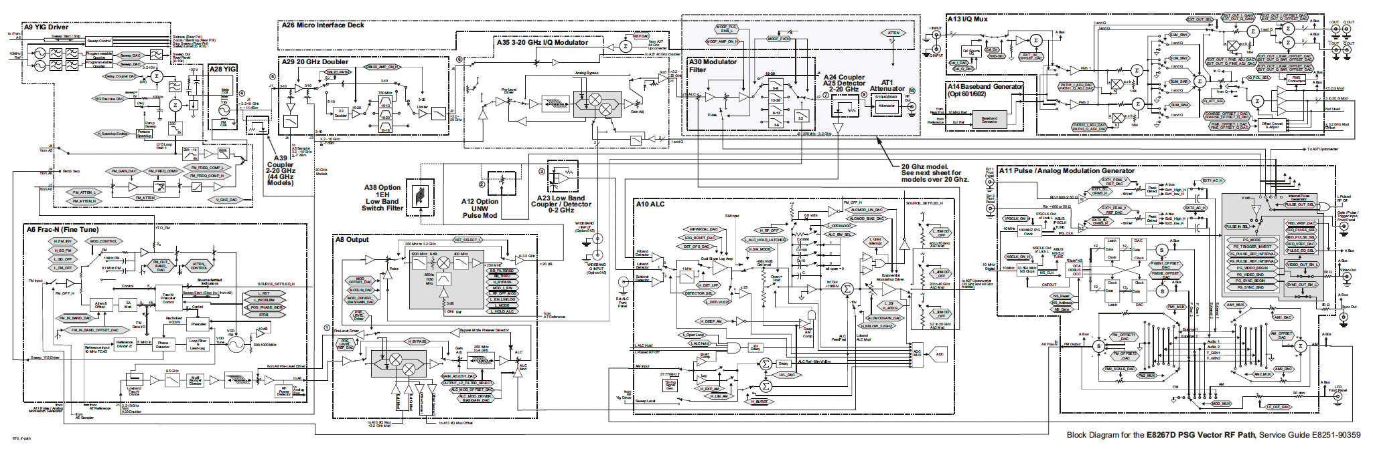
Agilent E8257D block diagram example

Slide 17
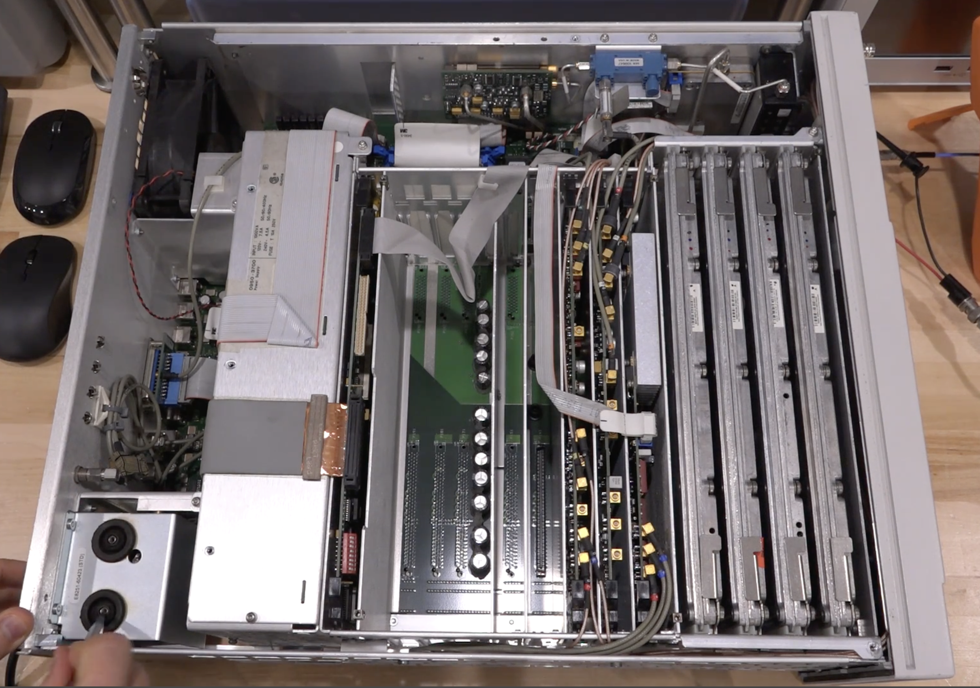
Agilent E8257D

Slide 18
Hands-on session 0 – Git
“A distributed system to track changes in source code, enabling multiple people to work together on non-linear development.”
Setup & Basics | Branch & Merge | Investigate & Fix
git init - Start repo | git branch - List branches | git log - View history
git clone <url> - Copy repo | git checkout <branch> - Switch | git status - Check changes
git add . - Stage all | git merge <branch> - Combine | git diff - See differences
git commit -m "msg" - Save | git branch -d <name> - Delete | git restore <file> - Undo changes
git push - Upload |  | git stash - Temporarily save
git pull - Download

Slide 19
Hands-on session 1 – Draw.IO

Slide 20
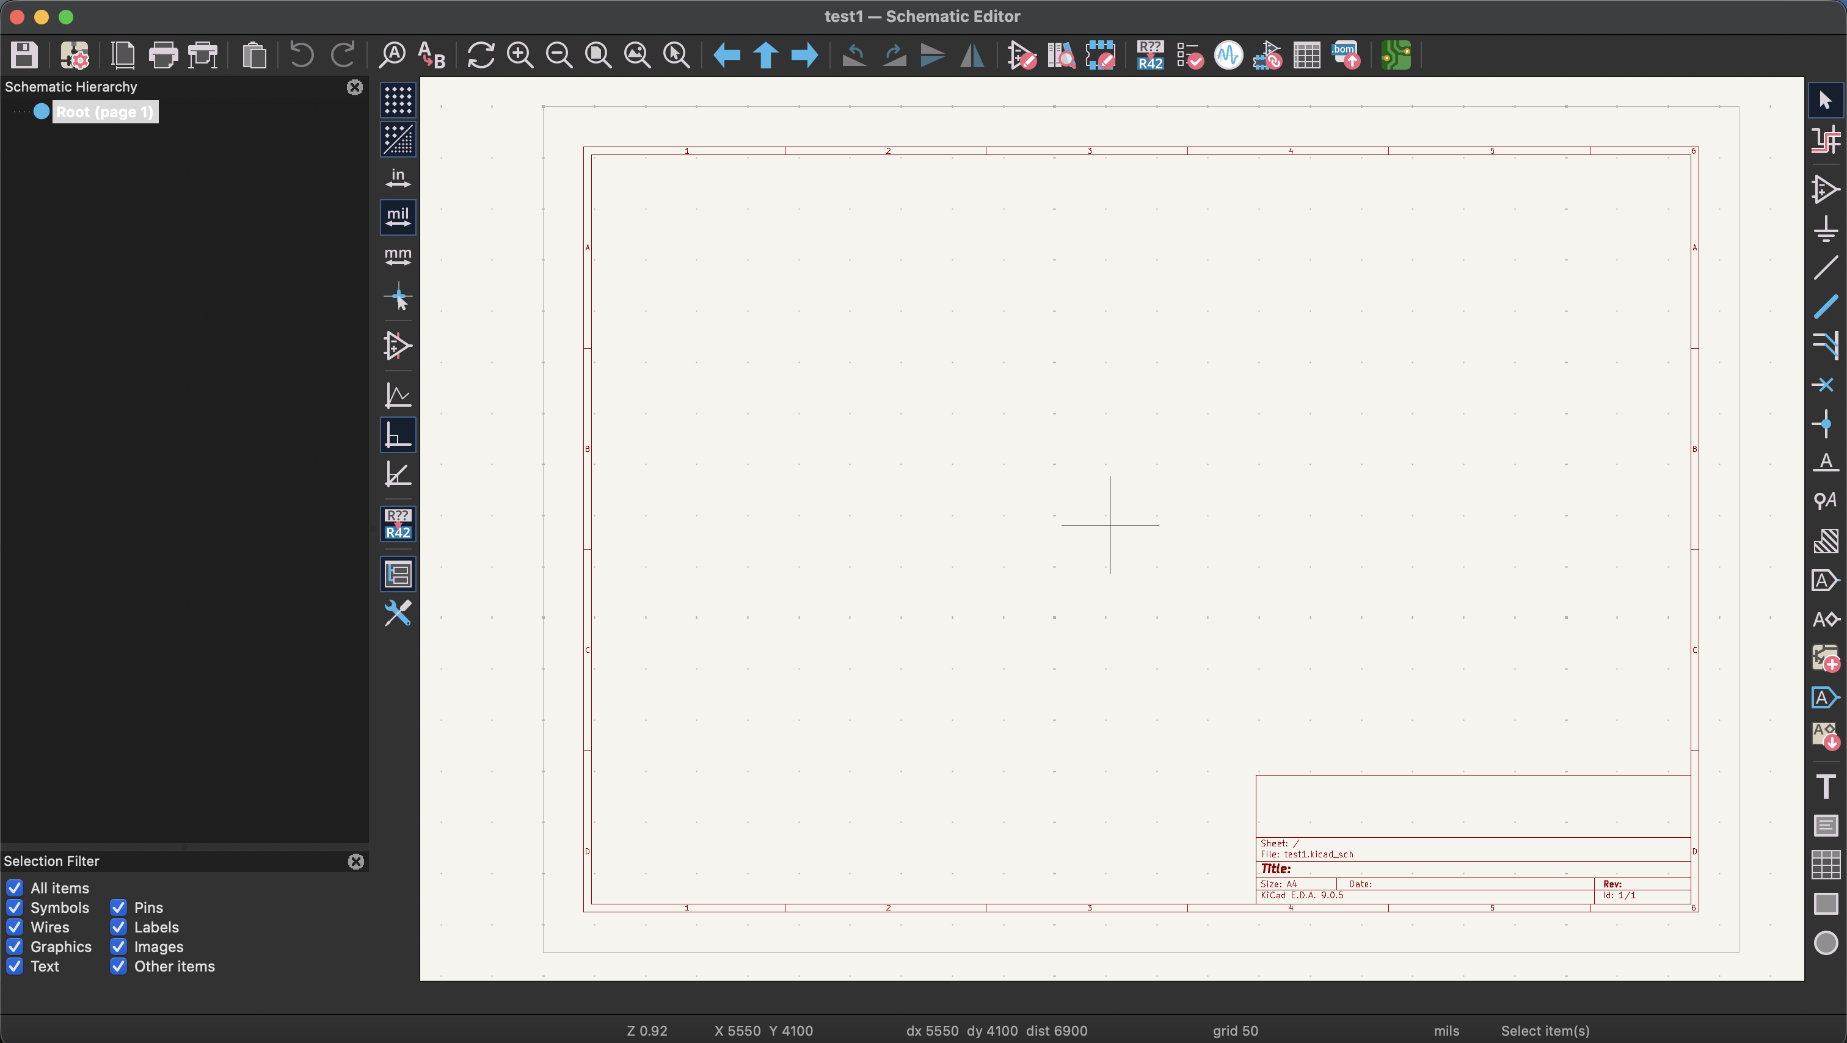
Schematic Design in KiCAD

Slide 21

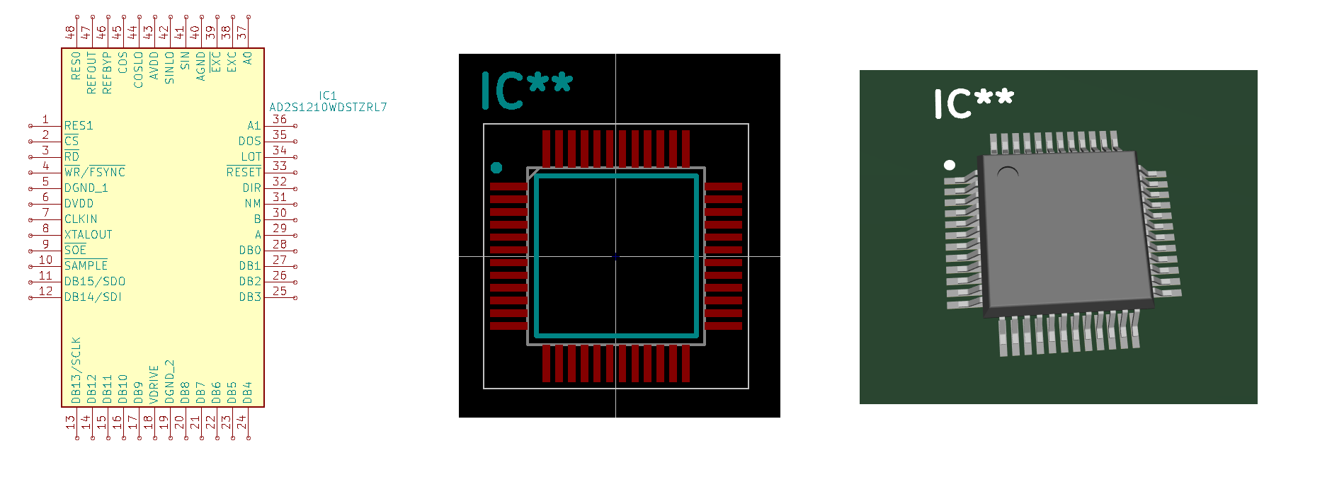
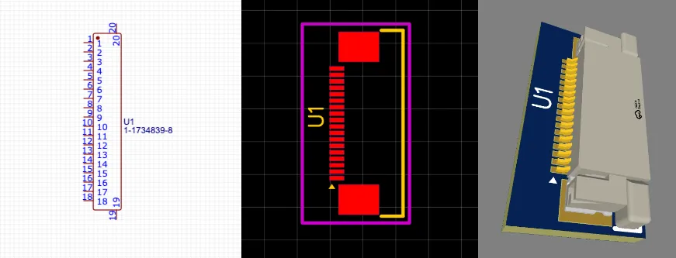
Symbol – Footprint and 3D model

Slide 22
Common schematic mistakes
Missing or insufficient decoupling capacitors
Incorrect reset circuit design
Floating inputs and unused pins
Power rails not properly filtered
Missing pull-up / pull-down resistors
No consideration of startup sequencing

Slide 23
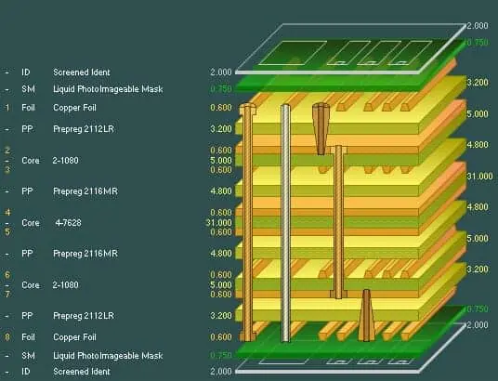
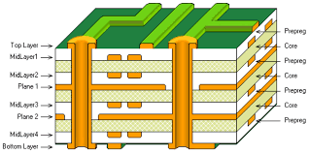
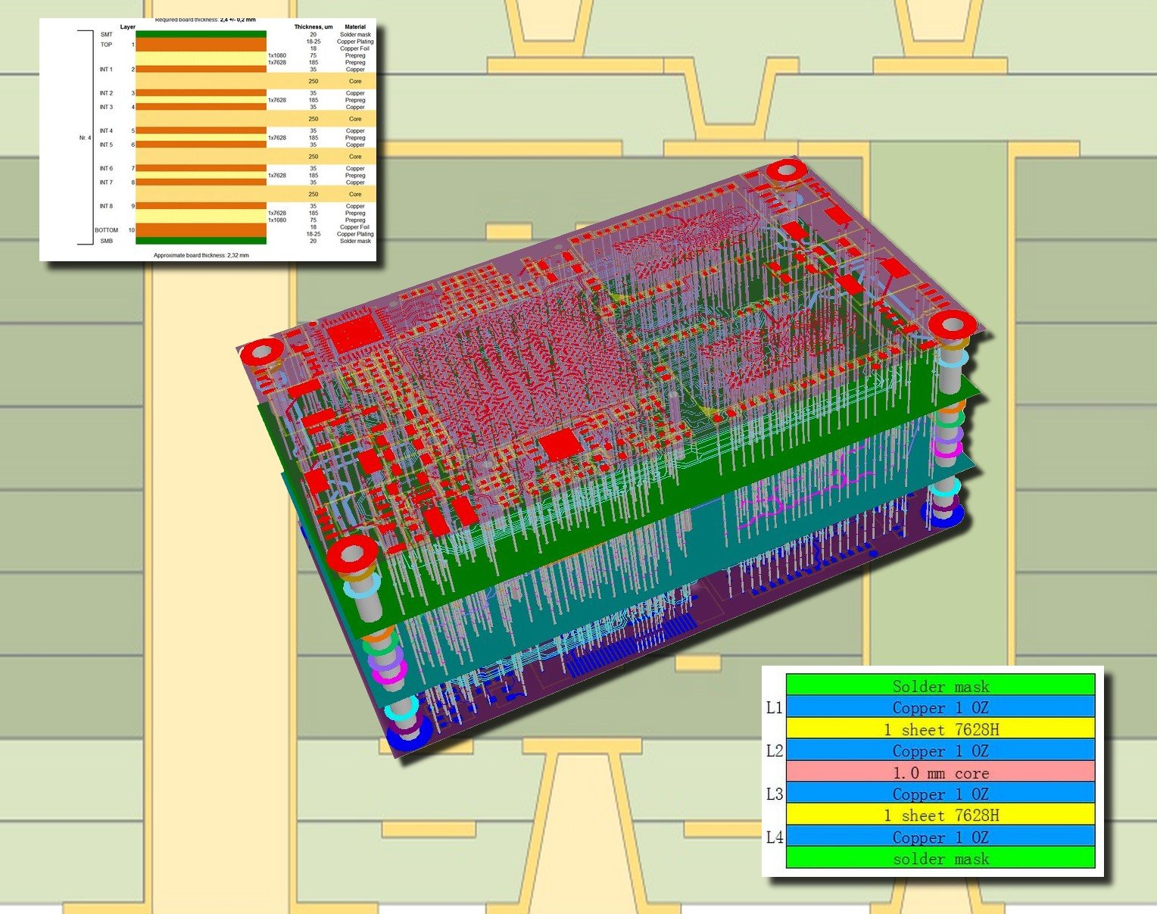
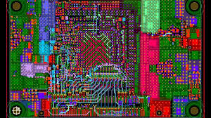

Slide 24
Simulation

Slide 25
Bill Of Materials

Slide 26
PCB Layout

Slide 27
(Simulation)

Slide 28
Manufacturing

Slide 29
Testing and validation

Slide 30
Hands-on session 2 - KiCAD

Slide 31
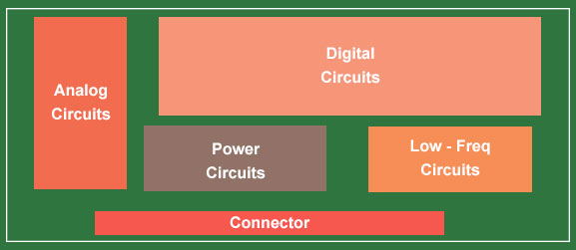

Slide 32
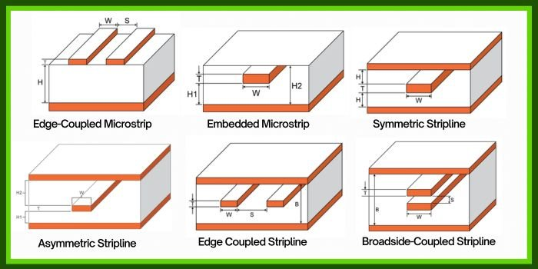

Slide 33
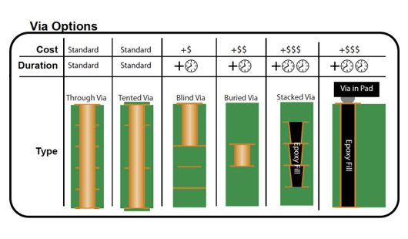
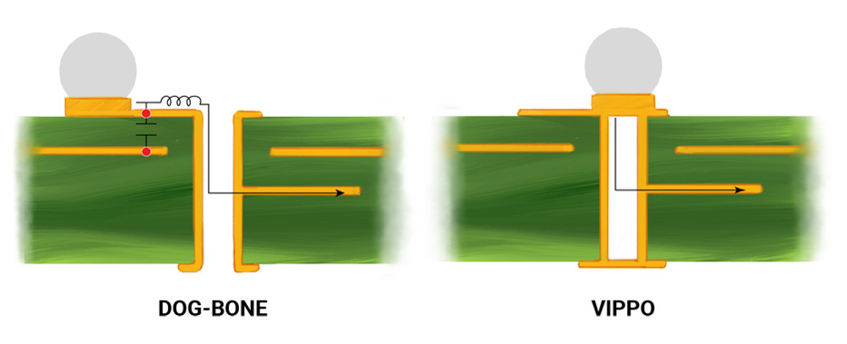
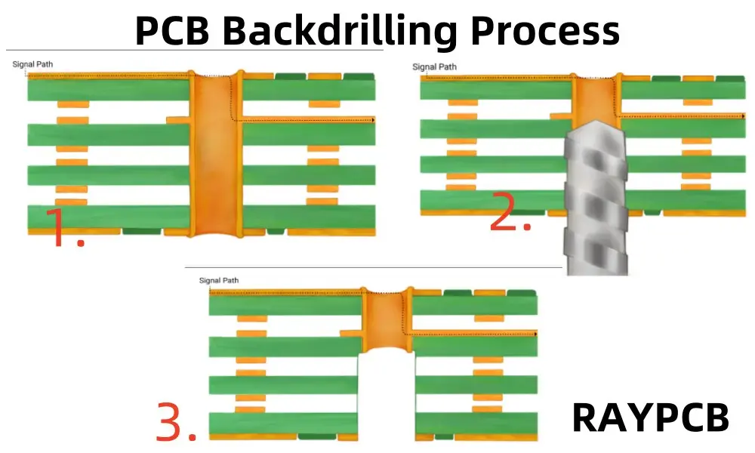
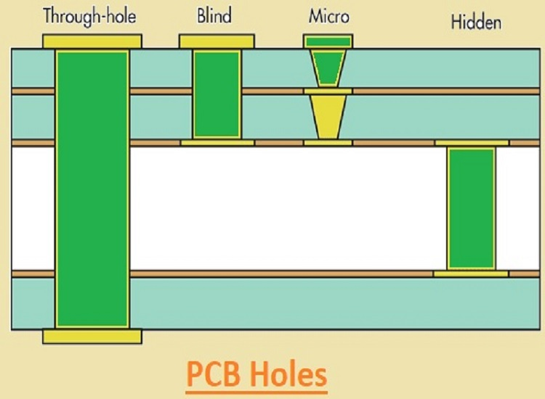

Slide 34
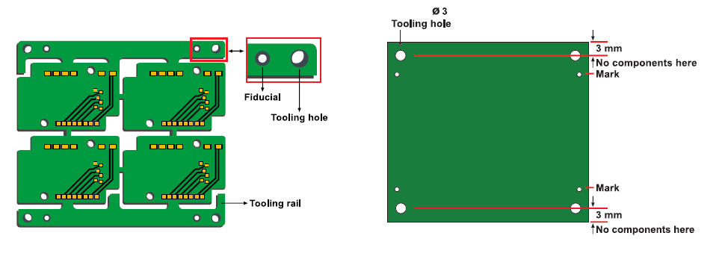
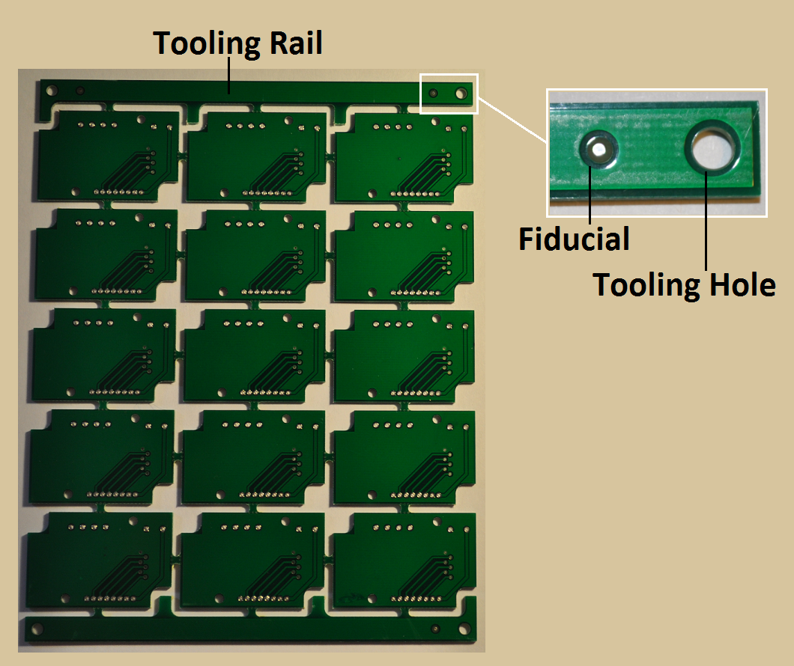
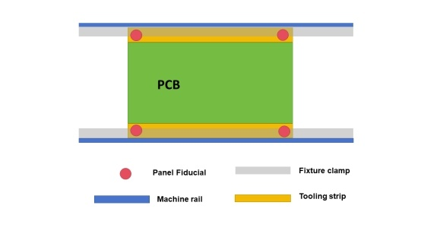
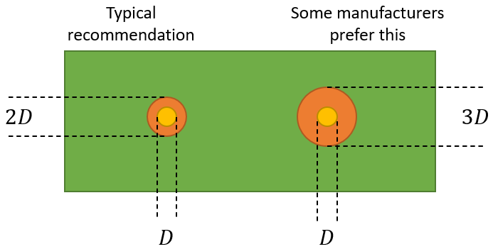
Fiducial and tooling holes

Slide 35
Common Power Supply Issues
Undersized voltage regulators
No bulk capacitors on power rails
Long power traces causing voltage drops
Sharing analog and digital supplies incorrectly
No ferrite beads or filtering where required

Slide 36
Common PCB Layout Mistakes
Poor component placement
Long clock or reset traces
No continuous ground plane
Splitting ground planes under high-speed signals
Decoupling capacitors placed too far from IC pins
Routing signals without considering return paths

Slide 37
Typical First-Power-On Failures
Wrong component orientation
Incorrect footprint
Missing power rail
Short circuits due to layout errors
Incorrect connector pinout

Slide 38
Common FPGA Design Mistakes
Using asynchronous logic unintentionally
Mixing blocking and non-blocking assignments incorrectly
Missing reset conditions
Multiple clock domains without synchronization
Ignoring timing constraints

Slide 39
Simulation vs Hardware Reality
Simulation works but hardware does not
Missing timing constraints
Uninitialized signals
Clock frequency assumptions wrong
Metastability not considered

Slide 40
Design for testabilty
Always start from power and clock
Verify reset behavior
Reduce the design to a minimal working configuration
Trust measurements, not assumptions
Change one thing at a time

